Slide 1
Heterodox (Śramaṇic schools)
Tanushree Sanwal
KIET

Slide 2
Śramaṇa movement
The Śramaṇa movement gave rise to diverse range of heterodox beliefs, ranging from accepting or denying the concept of soul, atomism, antinomian ethics, materialism, atheism, agnosticism, fatalism to free will, idealization of extreme asceticism to that of family life, strict ahimsa (non-violence) and vegetarianism to permissibility of violence and meat-eating. Notable philosophies that arose from Śramaṇic movement were Jainism, early Buddhism, Charvaka, Ajñana and Ājīvika.

Slide 3
Ajñana philosophy
Ajñana was one of the nāstika or "heterodox" schools of ancient Indian philosophy, and the ancient school of radical Indian skepticism.
It was a Śramaṇa movement and a major rival of early Buddhism and Jainism. They have been recorded in Buddhist and Jain texts. They held that it was impossible to obtain knowledge of metaphysical nature or ascertain the truth value of philosophical propositions; and even if knowledge was possible, it was useless and disadvantageous for final salvation. They were sophists who specialised in refutation without propagating any positive doctrine of their own.

Slide 4
Ājīvika philosophy
The philosophy of Ājīvika was founded by Makkhali Gosala, it was a Śramaṇa movement and a major rival of early Buddhism and Jainism.
Ājīvikas were organised renunciates who formed discrete monastic communities prone to an ascetic and simple lifestyle.

Slide 5
Original scriptures of the Ājīvika school of philosophy may once have existed, but these are currently unavailable and probably lost. Their theories are extracted from mentions of Ajivikas in the secondary sources of ancient Indian literature, particularly those of Jainism and Buddhism which polemically criticized the Ajivikas.
The Ājīvika school is known for its Niyati doctrine of absolute determinism (fate), the premise that there is no free will, that everything that has happened, is happening and will happen is entirely preordained and a function of cosmic principles.
Ājīvika considered the karma doctrine as a fallacy.
Ājīvikas were atheists and rejected the authority of the Vedas, but they believed that in every living being is an ātman – a central premise of Hinduism and Jainism

Slide 6
Charvaka philosophy
Charvaka or Lokāyata (लोकयता) was a philosophy of scepticism and materialism, founded in the Mauryan period. They were extremely critical of other schools of philosophy of the time. Charvaka deemed Vedas to be tainted by the three faults of untruth, self-contradiction, and tautology. Likewise they faulted Buddhists and Jains, mocking the concept of liberation, reincarnation and accumulation of merit or demerit through karma.^{[55]} They believed that, the viewpoint of relinquishing pleasure to avoid pain was the "reasoning of fools

Slide 7
Charvaka School
The Charvaka School was the main propounder of the materialistic view to achieve salvation. As it was geared towards the common people, the philosophy was soon dubbed as Lokayata or something derived from the common people. The word ‘Lokayata’ also meant a keen attachment to the physical and material world (loka). They argued for a complete disregard of any world beyond this world that was inhabited by a person. They denied the existence of any supernatural or divine agent who could regulate our conduct on earth

Slide 8
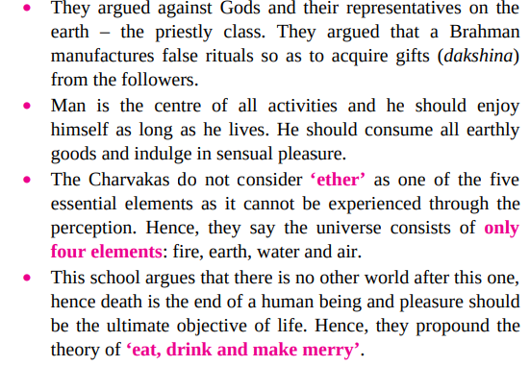
Main Teachings of Charvaka School

Slide 9
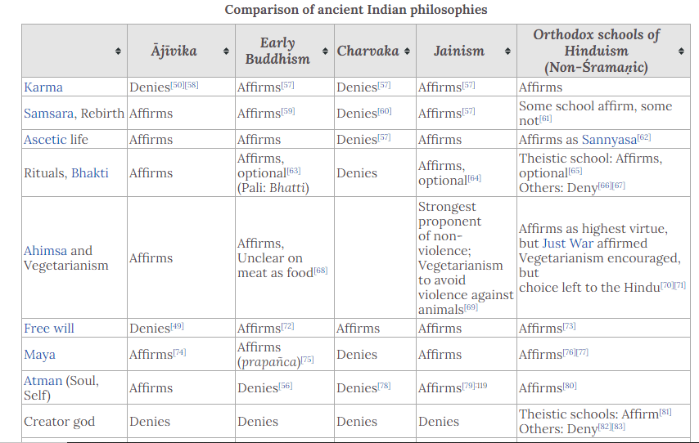

Slide 10
